Slide 1
SLA
By: Vijay Kumar Vishan

Slide 2
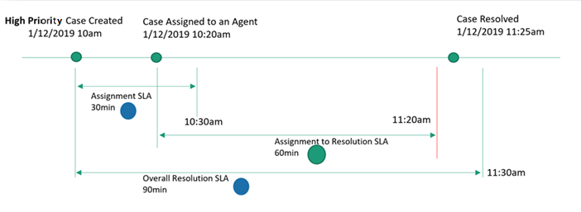
What is SLA?
A service level agreement (SLA) is an agreement between a service company and a service customer. In a SLA, the customer agrees to a minimum response time based on when the service company records the issue and when the issue is resolved.

Slide 3
Configure service-level agreements

Slide 4
Why?

Slide 5
When?

Slide 6
Thank you!!!

